Slide 1


Notes:
Joe Zack, a full-stack dev, focused on BE
Talking JAMstack, which is a front-end focused methodology for building web apps that has recently caught my attention.

Slide 2
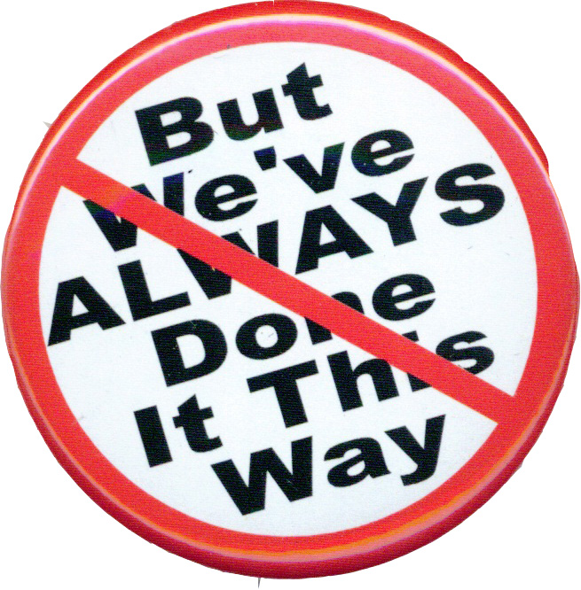
Notes:
Last time Alex had me here I gave a talk on Search Engines, and I spent a lot of that time comparing and frankly attacking relational databases. Don't get me wrong, I love relational databases, but I think that they are often over used and I don't like when organizations implicitly use them. Sometimes we don't even realize we are making a decision, because we aren't aware of alternatives. I want to fight that bias. I want to know what my options are, and I want my decisions to be explicit and informed in the hope that this makes for better decisions.
And that’s why I started looking at JAMstack.
I heard it was an interesting way of thinking about web applications that was making people question the way they did things.
I couldn’t resist that pitch, and now I’m bringing you that same message.
So put your skeptic’s hat on, and lets take a field trip to the front-end to see if the grass is any greener.
Show you what the JAMstack is
Why it’s gaining popularity
What it means for BE devs

Slide 3
JavaScript
APIs
Markup
Notes:
What is the JAMstack?
The JAMStack is a methodology for building web apps that is based on client-side JavaScript, reusable APIs, and prebuilt Markup and it’s gaining popularity at the expensive of some existing, entrenched technologies.
JavaScript
Client-Side JS
Framework agnostic
Build time rendering
Auth is handled outside the app, with API
APIs
All server-side processes or persistance are abstracted into APIs
All APIs are accessed over HTTPS from the JS
Treat your own server-side components as 3p
Plays nice with Microservices
Markup
Templated markup should be prebuilt at deploy time
Usually using a site generator or build tool

Slide 4
JAVASCRIPT
API
Markup
Notes:
Kinda sounds like websites?
How is this different from normal websites?
If anything, sounds like a step back-in time.
Building websites by hand?
Bear with me.

Slide 5
Best Practices
Static Website
CDN Hosting
Modern Build Tools
Single Git Repository
Atomic Deploys
Instant Cache Invalidation
Notes:
Where does the stack part come in?
Stack:
Misleading (MEAN, LAMP, Microsoft)
(Combination of complimentary technologies)
Have their own part to play and the result is greater than the sum of it’s parts
JAMstack is ambiguous
JAMstack is more of a methodology
Best practices that jive well with JAM
The app should be distributed on a CDN, the more on the edges, the better the UX
Modern Build Tools: Bable, WebPack, Gatsby, etc
Everything you need to run the app lives in a single git repository - simple npm install
Remember FTPing? Watchers more common now
Focus on automated builds, there is less emphasis on persistance, so changes generally need to be deployed
Atomic deploys (deploy everything at once instead of file by file)
Instant cache invalidation (use a CDN that can handle instant cache purges)

Slide 6
JAVASCRIPT
API
Markup
Notes:
What’s the difference?

Slide 7
Notes:
TODO Get numbers

Slide 8
Notes:
TODO Get numbers

Slide 9
The Benefits
Best performance
Best scalability
Best Pricing
Notes:
Static hosting on CDN is tough to beat
Perfect for side projects
Great FE experience
forced decoupling
targeted coding and debugging
Google loves it
Fast
PWA

Slide 10
Downsides?
Large Projects?
Non Developer Experiences?
Heavily Dynamic Content?
Notes:
Scales great for users...but how do large projects scale for devs?
Steep learning curve for non-devs
Heavily dynamic pages
Help from the audience!

Slide 11
Why now?
Proliferation of Managed Services
Netlify
GitHub
LetsEncrypt
Contently
Great tooling
React
Vue
Gatsby
Hugo

Slide 12

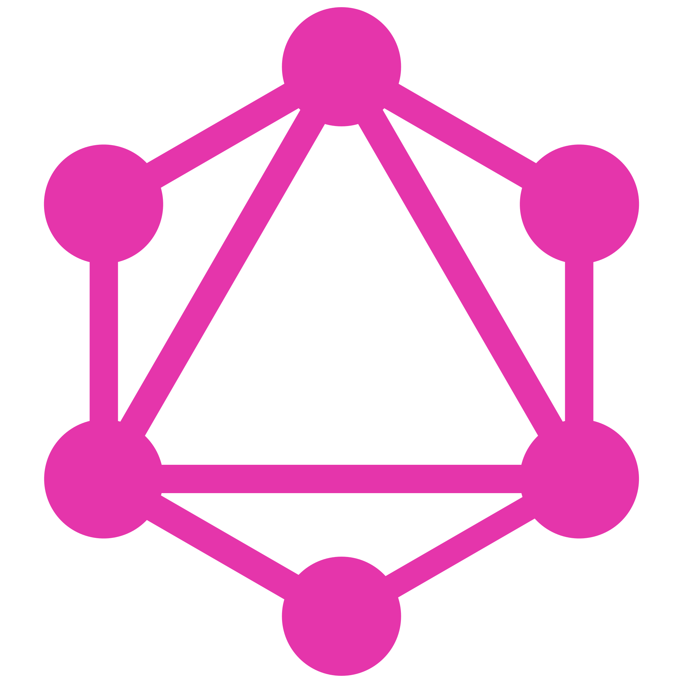
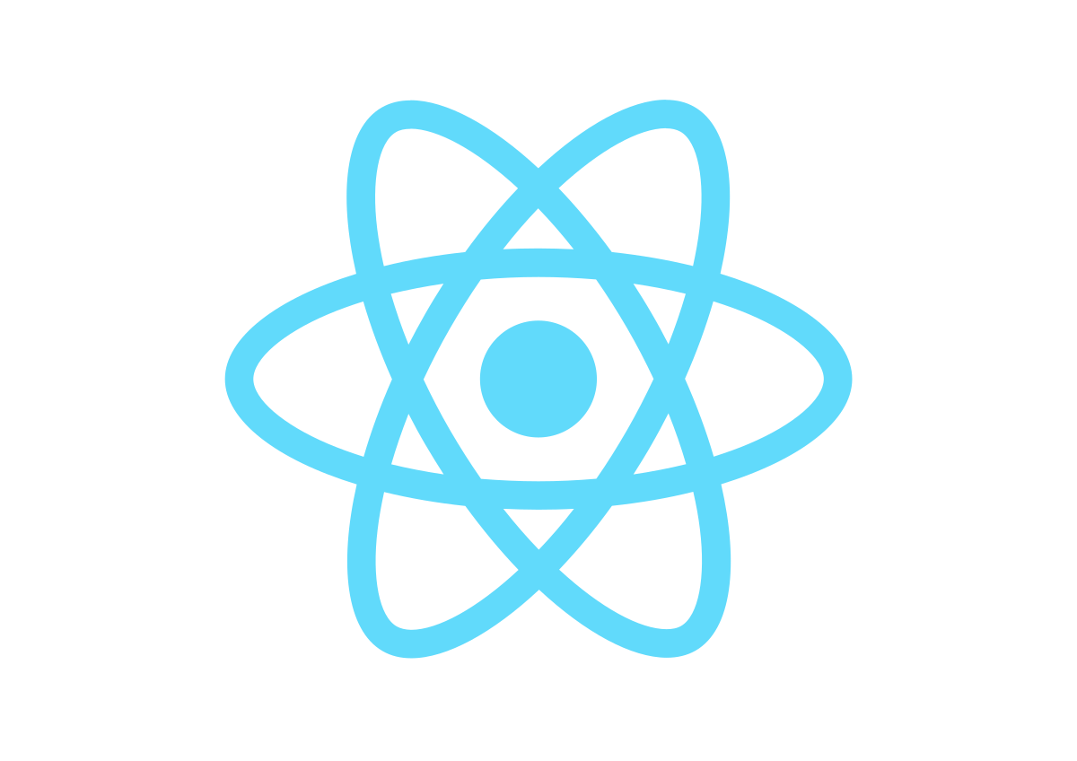
Notes:
Lets see some code
Gatsby
React (Server Side Includes, Templating)
GraphQL (Isolation Layer Between Persistence)
Plugins for ETL
Host in GitHub
Netlify builds, publishes

Slide 13
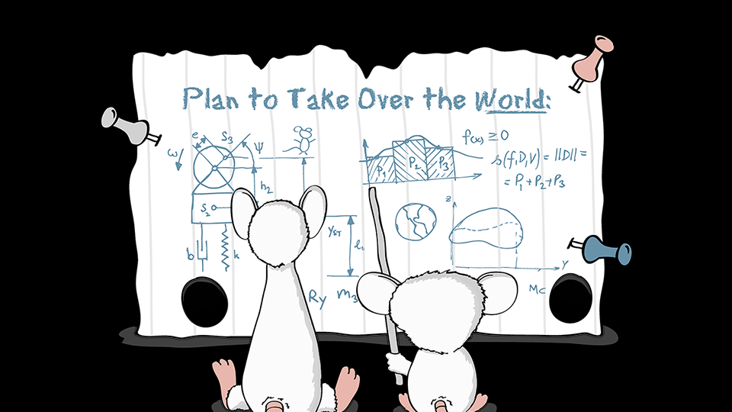
Notes:
Now we’ve seen what the JAMstack is all about, and what benefits it offers.
Lets talk about

Slide 14
What techs are losing ground?
Boutique sites
Traditional CMS
Server-Side Rendering Frameworks
Notes:
CMS: Wordpress, Ghost, Umbraco, Drupal
* Back-End Techs: LAMP, MEAN, ASP, Ruby on Rails, Django## Questions:* Why did we those "out" tools buy us, that we don't need now?* Remember website first? Mobile first? Should we now be thinking static first?* Is the back-end island shrinking? Cloud-y services, open-source, front-end expansion

Slide 15
Notes:
Last time Alex had me here I gave a talk on Search Engines, and I spent a lot of that time comparing and frankly attacking relational databases. Don't get me wrong, I love relational databases, but I think that they are often over used and I don't like when organizations implicitly use them. Sometimes we don't even realize we are making a decision, because we aren't aware of alternatives. I want to fight that bias. I want to know what my options are, and I want my decisions to be explicit and informed in the hope that this makes for better decisions.
And that’s why I started looking at JAMstack.
I heard it was an interesting way of thinking about web applications that was making people question the way they did things.
I couldn’t resist that pitch, and now I’m bringing you that same message.
So put your skeptic’s hat on, and lets take a field trip to the front-end to see if the grass is any greener.
Show you what the JAMstack is
Why it’s gaining popularity
What it means for BE devs

Slide 16

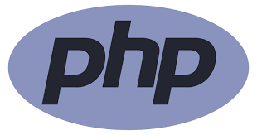

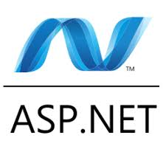

What value does the back-end provide?
Notes:
What are the back-ends strengths?
Maybe it’s time to let server-side rendering and includes
Server-Side Includes + Rendering?
Are those days over?
API layer

Slide 17
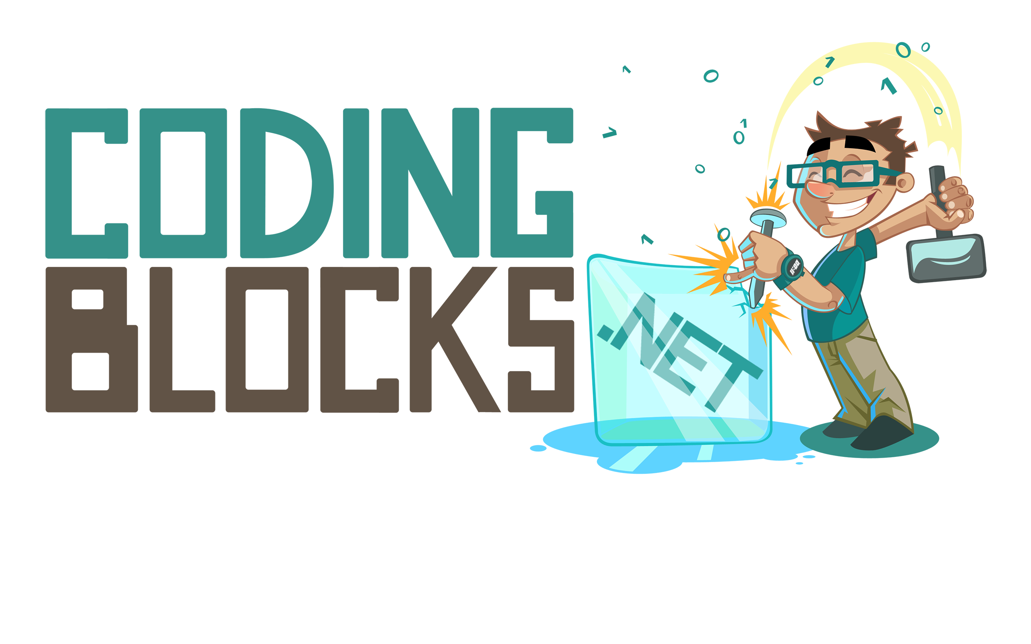
Like this talk? Check out the show!
Joe Zack
@codingblocks
github.com/codingblocks
Notes:
What JAMstack is
Why it’s gaining ground
What it means for Back-End Developers
If you like this kind of talk, check out the podcast or youtube channel.

